Slide 1
WS-011 Windows Server 2019 Administration

Slide 2
Module 5: Hyper-V virtualization and containers in Windows Server
Notes:
Presentation: 120 minutes
Lab: 60 minutes
After completing this module, students will be able to:
Describe key features of Hyper-V in Windows Server.
Deploy and configure virtual machines in Hyper-V.
Describe how to secure a virtual infrastructure using Hyper-V.
Describe and deploy containers in Windows Server.
Describe container orchestration using Kubernetes.

Slide 3
Module overview
In this module, you learn the key features of the Hyper-V server role in Windows Server. You learn how
to configure Hyper-V networking, storage, and how to manage the state of a virtual machine. You also
learn how to secure the Hyper-V host and associated virtual machines using security features
within a guarded fabric provided by Windows Server.
The final lessons of this module introduce you to the concept of using and managing containers
  Lessons:
    Lesson 1: Hyper-V in Windows Server
    Lesson 2: Configuring VMs
    Lesson 3: Securing virtualization in Windows Server
    Lesson 4: Containers in Windows Server
    Lesson 5: Overview of Kubernetes

Slide 4
Lesson 1: Hyper-V in Windows Server

Slide 5
Lesson 1 overview
In this lesson, you learn how to use Hyper-V to implement virtualization. You also learn best practices for
configuring Windows server hosts, and considerations related to deployment scenarios such as
nested virtualization.
Finally, you will learn considerations, requirements, and processes for migrating on-premises
Hyper-V virtual machines to Microsoft Azure
  Topics:
    Overview of Hyper-V
    Overview of Hyper-V Manager
    Best practices for configuring Hyper-V hosts
    Overview of nested virtualization
    Migration to Azure VMs

Slide 6
Overview of Hyper-V (1 of 2)
  Hyper-V is a hardware virtualization server role available for Windows Server
  Provides a software layer known as the Hypervisor, used to control access to physical hardware
  Supports many types of guest operating systems including:
    All supported Windows versions
    Linux
    FreeBSD
  General Hyper-V features can be grouped as follows:
    Management and connectivity
    Portability
    Disaster recovery and backup
    Security
    Optimization
Notes:
Describe the use scenarios and system requirements for Hyper-V.
Explain that to install the Hyper-V components such as the hypervisor, the processor must support
SLAT; however, it is not required to install just the Hyper-V management tools such as the Hyper-V Manager, Hyper-V cmdlets for Windows PowerShell, and the Virtual Machine Connection tool.
In addition to these general system requirements, specific features may have additional requirements. For example, Shielded virtual machines have additional host machine requirements such as UEFI 2.3.1c, Intel VT-D, and TPM v2.0. Virtual machines also need to be created in generation 2 format.
Consider demonstrating the Add Roles and Features wizard to show where one would install the Hyper-V server role. Do not finish the install, but rather just demonstrate the steps needed to complete the task.

Slide 7
Overview of Hyper-V (2 of 2)
  System requirements for installing the Hyper-V server role include:
    A 64-bit processor with second-level address translation (SLAT)
    A processor with VM Monitor Mode extensions
    Sufficient memory
    Intel Virtualization Technology (Intel VT) or Advanced Micro Dynamics (AMD) Virtualization (AMD-V) enabled
    Hardware-enforced Data Execution Prevention (DEP) enabled (Intel Execute Disable (XD) bit, AMD No Execute (NX) bit)
  Methods to install the Hyper-V server role include:
    Server Manager
    Install-WindowsFeature PowerShell cmdlet

Slide 8
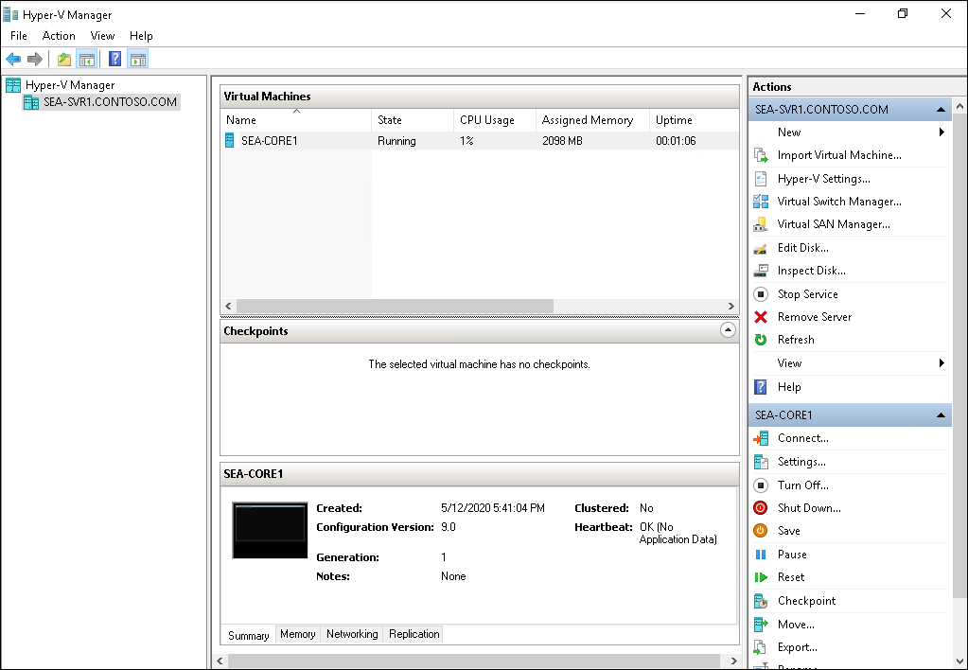
Overview of Hyper-V Manager
  A graphical user interface used to manage both local and remote Hyper-V host machines
  Supports:
    Previous versions
    Web Services (WS)-Management protocol
    Alternate credential support
  Other management tools include:
    Windows PowerShell
    PowerShell Direct
    Windows Admin Center
Notes:
Describe the Hyper-V Manager and the features that are used to connect to and manage virtual machines and switches. You may want to start the Hyper-V Manager on SEA-ADM1 to show an example as you discuss the console.
Also describe other methods for managing Hyper-V, including PowerShell, PowerShell Direct, and Windows Admin Center.

Slide 9
Best practices for configuring Hyper-V hosts
  Consider the following when provisioning Windows Server as a Hyper-V host:
    Provision the host with adequate hardware
    Deploy virtual machines on separate disks, solid state drives, or Cluster Shared Volumes (CSVs) if using shared storage
    Do not collocate other server roles
    Manage Hyper-V remotely
    Run Hyper-V by using a Server Core configuration
    Run the Best Practices Analyzer and resource metering
    Use Generation 2 virtual machines if the guest operating system supports them
Notes:
Describe the best practices for configuring Hyper-V hosts and running virtual machines.

Slide 10
Overview of nested virtualization
  Provides the ability to install the Hyper-V role within a guest virtual machine
  Requirements:
    Both the Hyper-V host and the guest virtual machine must be Windows Server 2016 or later
    Sufficient amount of static RAM
    Virtual machines must have a configuration version of 8.0 or greater
    Physical host computer mush have an Intel processor with VT-x and Extended Page Tables (EPT) technology
    MAC address spoofing enabled
    Set-VMProcessor -VMName <VMName> -ExposeVirtualizationExtensions $true
Notes:
Describe the Hyper-V nested virtualization feature. You may also want to state that a second option for networking with nested virtual machines is to create a virtual NAT Network (using the New-NetNat command) on the physical host machine.
This option might be best where MAC address spoofing is not possible.

Slide 11

Migration to Azure VMs
  Azure Migrate can be used to migrate on-premises workloads, apps, and virtual machines
  Azure Migrate provides the following benefits:
    A single migration platform
    Assessment and migration tools
      Azure Migrate: Server Assessment
      Azure Migrate: Server Migration
    Ability to assess and migrate multiple object types:
      Servers
      Databases
      Web applications
      Virtual desktops
      Data
Notes:
Describe the concept of migrating Hyper-V VMs to Azure. Some students might be familiar with the previous method of using Microsoft Azure Site Recovery. Mention that the Azure Migrate tool uses the same architectural components but is designed as a migration tool as opposed to a disaster recovery tool.

Slide 12
Lesson 1: Test your knowledge
Refer to the Student Guide for lesson-review questions

Slide 13
Lesson 2: Configuring VMs

Slide 14
Lesson 2 overview
In this lesson, you learn the concepts related to virtual machine configurations and generation versions. You also learn VM settings, storage options, and virtual disk types. Finally, you learn about the types of virtual networks and how to create and manage a virtual machine.
  Topics:
    VM configuration and generation versions
    VM settings
    Storage options in Hyper-V
    Virtual hard disk formats and types
    Shared VHDX and VHD Set files
    Overview of Hyper-V networking
    Networking features for Hyper-V
    Manage VM states and checkpoints
    Import and export VMs
    Demonstration: Create and manage a VM

Slide 15
VM configuration and generation versions
  VM configuration version identifies:
    Compatibility of the VM components with the version of Hyper-V
    installed on the host machine
    Windows Server 2019 host machines support configuration version 9.0
    To update a configuration version, use the following command:
      Update-VMVersion <vmname>
  Generation 1 VMs:
    Support 32 and 64-bit operating systems
    Only support boot volumes a maximum of 2 TB
    Supports legacy BIOS
  Generation 2 VMs:
    Support only 64-bit operating systems
    Support secure boot and shielded VMs
    Support boot volumes a maximum of 64 TB
    Supports Unified Extensible Firmware Interface (UEFI)
Notes:
Describe the decisions required for choosing a virtual machine configuration version and generation version.
You should also state that generation 2 virtual machines do not use emulation for keyboard, mouse, and video, which also results in using fewer resources and reducing the attack surface from the guest operating system.

Slide 16
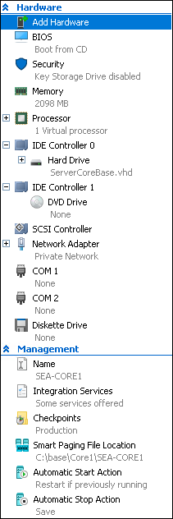
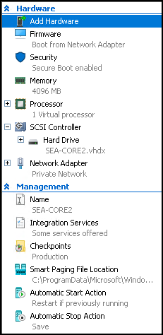
VM settings
  Generation 1 settings
  VM settings are grouped into two main areas:
    Hardware
    Management
  Available hardware components depend on the generation version of the VM
  Generation 2 settings
Notes:
Describe the virtual machine settings. These are displayed in the Settings dialog box for a virtual machine in Hyper-V Manager.

Slide 17
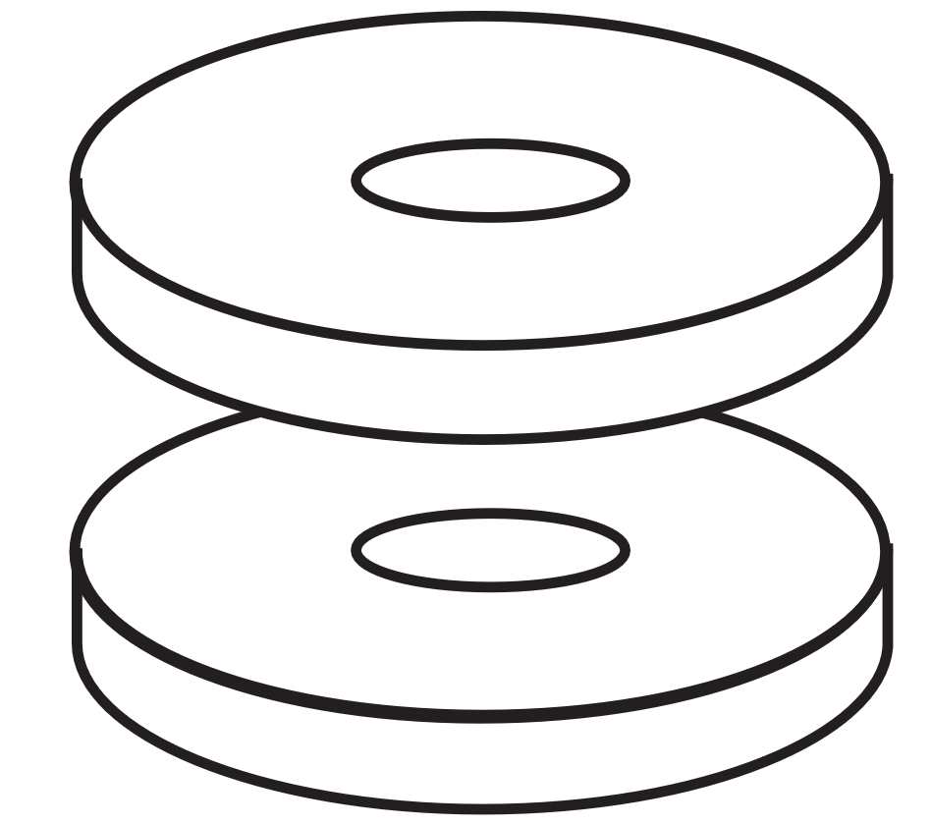
Storage options in Hyper-V
  Consider the following factors when planning storage for virtual hard disks:
    High-performance connection to storage
    Redundant storage
    High-performance storage
    Adequate growth space
  Supported storage types include:
    Fibre channel connections
    Server Message Block (SMB) 3.0 file shares
Notes:
Provide an overview of storage options for Hyper-V. Focus this discussion on considerations for where to store the Hyper-V files. The next couple of topics will cover the details on the types and formats of Hyper-V files.

Slide 18
Virtual hard disk formats and types (1 of 2)
  Virtual hard disk formats include:
    VHD
      Up to 2040 GB in size
      Typically used to support older Hyper-V versions
    VHDX:
      Up to 64 TB in size
      Recovery from corruption issues
      Supports larger block size resulting in increased performance
  Use the Edit Virtual Hard Disk Wizard to convert between hard disk formats
  Various tools can be used to create and mange virtual hard disks:
    Hyper-V Manager
    Disk Management/Diskpart
    PowerShell (New-VHD)
    Windows Admin Center
Notes:
Provide an overview of the virtual hard disk (VHD) formats and types. Point out that .VHD files were used in previous versions of Windows Hyper-V. Windows Server 2012 introduced the .vhdx file format. You may also want to mention that when you create a new dynamically expanding disk, .vhd files start at approximately 260 kilobytes (KB). VHDX files start at approximately 4,096 KB. Also point out that if using differencing disks, care needs to take place for the parent disk. If the parent disk is modified, linked differencing disks may fail. Also, if you move the parent disk, you will need to relink the differencing disks to point to the new location.

Slide 19
Virtual hard disk formats and types (2 of 2)
Type of disc | Description
Fixed | Allocates all of the hard disk space immediately
Dynamic | The disk only uses the amount of space that needs to be allocated, and it grows as necessary
Differencing | Associated with another virtual hard disk in a parent-child configuration. Any changes made to the differencing disk does not affect the parent disk.
Pass through | Allows the virtual machine to connect directly to an Internet Small Computer Systems Interface (iSCSI) (logical unit number) LUN or a physical disk attached on the host machine

Slide 20
Shared VHDX and VHD Set Files
Virtual machine cluster node 1
Virtual machine cluster node 2
Shared VHDX or VHD Set (VHDS)
Notes:
Point out that sharing a virtual disk is typically used in failover clustering scenarios. Using a VHD Set is the recommended method over the legacy Shared VHDX method when using the latest versions of Windows Server.

Slide 21
Overview of Hyper-V networking
  Hyper-V supports the following virtual network adapter types:
    Legacy network adapter
    Synthetic network adapter
  Hyper-V supports three types of virtual switches:
Virtual switch type | Description
External | Used to map a network to a specific network adapter or network adapter team. Provides external access outside of the host machine.
Internal | Used to communicate between the virtual machines on a host server and to communicate between the virtual machines and the host itself
Private | Used to only communicate between virtual machines on a Hyper-V host
Notes:
Provide an overview of Hyper-V networking by introducing virtual network adapters and virtual switches.
Explain that typically, you would select the standard Network Adapter; however, if you need the virtual machine to be able to boot to the network, then a Legacy Network Adapter is required. Also explain that the External switch is used to configure direct access to an external network. However, if a private network is routed through a router (such as a virtual machine configured as a router), it can also access external networks such as the Internet.

Slide 22
Networking features for Hyper-V (1 of 2)
NIC
teaming
VMQ
Port mirroring
IPsec task offloading
Hyper-V
networking
Router
guard
SR-IOV
Network
virtualization
DHCP guard
Bandwidth management
Notes:
Provide an overview of the features that support Hyper-V networking. Point out that some of these are Network Adapter settings, while others are switch configuration options.

Slide 23
Networking features for Hyper-V (2 of 2)
SET
RDMA
VMMQ
Hyper-V networking
Converged network adapters
NAT Virtual switch

Slide 24
Manage VM states and checkpoints
  A VM can be in one of the following states:
    Off
    Starting
    Running
    Paused
    Saved
  Checkpoints:
    Allows you to take a snapshot of a virtual machine at a specific point in time
    Two types of checkpoints
      Production checkpoints
      Standard checkpoints
    Maximum of 50 checkpoints per virtual machine allowed
Notes:
As you describe the use of checkpoints, stress that these are not a replacement for backups. Checkpoints used to be called snapshots in previous Windows versions. You may want to explain and show how to disable checkpoints for a specific VM by opening the Settings box of a VM. The option is located on the Checkpoints page.

Slide 25
Import and export VMs
  When importing a VM you have three options:
    Register the virtual machine in-place (use the existing unique ID)
    Restore the virtual machine (use the existing unique ID)
    Copy the virtual machine (create a new unique ID)
  Export options:
    Export a specific checkpoint
    Export a virtual machine with all checkpoints
Notes:
Describe options for importing and exporting VMs.

Slide 26
Demonstration: Create and manage a VM
Configure a Hyper-V virtual switch
Create a virtual hard disk
Create a virtual machine
Manage Virtual Machines using
Windows Admin Center
Notes:
Demonstration detailed steps
Preparation Steps
The following VMs are required for this demonstration:
WS-011T00A-SEA-DC1
WS-011T00A-SEA-ADM1
WS-011T00A-SEA-SVR1
Sign in as Contoso\Administrator by using Pa55w.rd as the password.
Configure a Hyper-V virtual switch
On SEA-ADM1, select Start and then select Server Manager.
In Server Manager, select All Servers.
In the Servers list, right-click SEA-SVR1, and then select Hyper-V Manager.
In Hyper-V Manager, ensure that SEA-SVR1.Contoso.com is selected.
In the Actions pane, select Virtual Switch Manager.
In the Virtual Switch Manager, in the Create virtual switch pane, select Private, and then select Create Virtual Switch.
In the Virtual Switch Properties box, enter the following details, and then select OK:
Name: Contoso Private Switch
Connection type: Private network
Create a virtual hard disk (VHD)
On SEA-ADM1, in Hyper-V Manager, select New and then select Hard Disk. The New Virtual Hard Disk Wizard starts.
On the Before you Begin page, select Next.
On the Choose Disk Format page, select VHD, and then select Next.
On the Choose Disk Type page, select Differencing, and then select Next.
On the Specify Name and Location page, enter the following, and then select Next:
Name: SEA-VM1
Location: default location
On the Configure Disk page, in the Location box, enter C:\Base\BaseImage.vhd, and then select Next.
On the Summary page, select Finish.
Create a virtual machine (VM)
On SEA-ADM1, in Hyper-V Manager, select New, and then select Virtual Machine. The New Virtual Machine Wizard starts.

Slide 27
Demonstration: Create and manage a VM (2 of 2)
Configure a Hyper-V virtual switch
Create a virtual hard disk
Create a virtual machine
Manage Virtual Machines using
Windows Admin Center
Notes:
On the Before you Begin page, select Next.
On the Specify Name and Location page, enter SEA-VM1, and then select Next.
On the Specify Generation page, select Generation 1, and then select Next.
On the Assign Memory page, enter 4096, and then select Next:
On the Configure Networking page, select the drop-down menu, select Contoso Private Switch, and then select Next.
On the Connect Virtual Hard Disk page, select Use an existing virtual hard disk, and then select Browse.
Select SEA-VM1.vhd and then select Open. Select Next.
On the Summary page, select Finish. Notice that SEA-VM1 displays in the Virtual Machines list.
Select SEA-VM1, and then in the Actions pane, under SEA-VM1, select Settings. Describe the various Hardware components, and then select Cancel.
Close Hyper-V Manager.
Manage Virtual Machines (VMs) using Windows Admin Center
On SEA-ADM1, on the Task Bar, select Microsoft Edge.
In Microsoft Edge, on the Favorites Bar, select Windows Admin Center.
In the Windows Security box, enter Contoso\Administrator by using Pa55w.rd as the password, and then select OK.
In the All connections list, select SEA-SVR1.
In the Specify your credentials page, select Use another account for this connection, and then enter Contoso\Administrator by using Pa55w.rd as the password.
In the Tools list, select Virtual Machines. Show the Summary pane.
Select the Inventory tab. Notice the two VMs.
Select SEA-VM1. Show the Properties pane.
Select Settings. Describe the various settings, and then select Disks.
Select Add disk.
Select Create an empty virtual hard disk, and then in the Size box type 5 GB.
Select Close.
On the Properties page, select Start to start SEA-VM1. Scroll down and view the statistics for the running VM.
Refresh the page, and then select Shut down. Select Yes to confirm.
In the Tools list, select Virtual switches. Point out the two switches that have been configured. Explain that it is here that you can also create new switches and manage the existing switches.
Keep the VMs running for the next demonstration.

Slide 28
Lesson 2: Test your knowledge
Refer to the Student Guide for lesson-review questions

Slide 29
Lesson 3: Securing virtualization in Windows Server

Slide 30
Lesson 3 Overview
Hyper-V supports the concept of a guarded fabric to provide a more secure environment for virtual machines
In this lesson, you are introduced to the concept of implementing a guarded fabric, including the Host Guardian Service, guarded host servers, and shielded virtual machines
  Topics:
    Guarded fabric
    Attestation modes for guarded fabric
    Host Guardian Service
    Types of protected VMs in a guarded fabric
    General process for creating shielded VMs
    Process for powering-on shielded VMs

Slide 31
Guarded fabric (1 of 2)
  A security solution used to protect virtual machines against:
    Inspection
    Theft
    Tampering from either malware or malicious intent
  Security benefits of a guarded fabric include:
    Secure and authorized Hyper-V hosts
    Verification that a host is in a heathy state
    Providing a secure method to release keys to healthy hosts
Notes:
Provide an overview of the concept of a guarded fabric. Use the diagram on the PowerPoint slide to visually represent each of the components that you introduce.

Slide 32
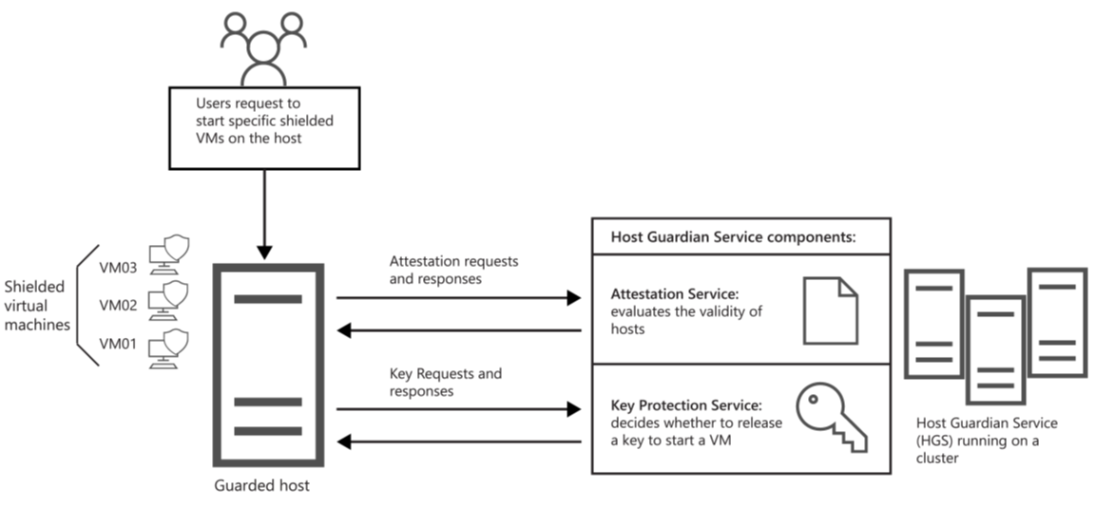
Guarded fabric (2 of 2)
  Guarded fabric is made up of the following components:
    Guarded Hyper-V hosts
    Host Guardian Service
    Shielded or encryption-supports virtual machines
  Tools used to automate and manage a guarded fabric:
    System Center Virtual Machine Manager (VMM)
    Windows Azure Pack
    PowerShell
Notes:
Introduce each of the components
Guarded Hyper-V hosts
Host Guardian Service
Shielded or encryption-supports virtual machines
Also include tools used to automate and manage a guarded fabric.

Slide 33
Attestation modes for guarded fabric
  Guarded fabric attestation is the process of evaluating and validating the Hyper-V host
Attestation mode | Description
Trusted Platform Module (TPM)-trusted attestation | Hardware-based attestation method offering the strongest protection but does require a more complex configuration and higher host hardware requirements Requirements include TPM 2.0 and UEFI 2.3.1 with Secure Boot enabled A guarded Hyper-V host is approved and validated based upon its TPM identity, Measured Boot sequence, and code integrity policies
Host key attestation | Based upon asymmetric key pairs Used when existing Hyper-V host machines do not support TPM 2.0 A guarded Hyper-V host is approved and validated based upon possession of the key
Notes:
Describe the attestation modes used to validate a Hyper-V host in a guarded fabric infrastructure.

Slide 34
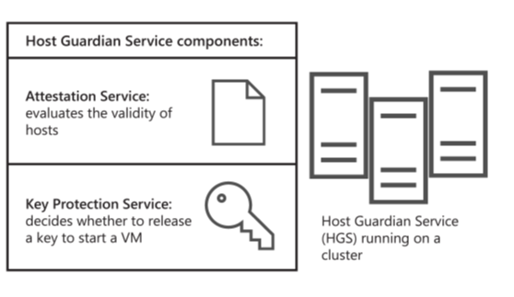
Host Guardian Service
  Host Guardian Service includes:
    Attestation service
    Key Protection Service (KPS)
  Helps to ensure:
    Protected VMs contain BitLocker encrypted disks
    Shielded VMs are deployed from trusted template disks and images
    Passwords and other secrets are protected when a shielded VM is created
    Control of where the shielded VM can be started
Notes:
Provide a high-level overview of what the Host Guardian Service is and considerations for implementing it.

Slide 35
Types of protected VMs in a guarded fabric
  A guarded fabric is capable of running:
    Shielded VMs
    Encryption-supported VMs
    Normal VMs
Capability | Encryption-supported | Shielded
Secure boot | Yes, required but configurable | Yes, required and enforced
Virtual TPM | Yes, required but configurable | Yes, required and enforced
Encrypt VM state and live migration traffic | Yes, required but configurable | Yes, required and enforced
Integration components | Configurable by fabric admin | Certain components blocked such as PowerShell Direct (enabled in Windows Server v1803), and data exchange
Virtual machine connection, HID devices (keyboard, mouse) | On, cannot be disabled | Enabled for hosts starting at Windows Server v1803; Disabled on earlier hosts
COM/Serial ports | Supported | Disabled (cannot be enabled)
Attach a debugger to the VM process | Supported | Disabled (cannot be enabled)
Notes:
Describe the differences between encryption-supported and shielded VMs. Point out that both are considered secure; however, encryption-supported VMs allow more flexibility for trusted fabric administrator configuration changes.

Slide 36
General process for creating shielded VMs
Create a shielded VM template disk
Create a shielded data file
Deploy a shielded VM
VHDX disk type
Globally Unique Identifiers (GUID) partition table
2 partitions
NTFS file system
Support OS
OS must be generalized
BitLocker encrypted
Shielded Template Disk Creation Wizard
Also called a provisioning data file (PKD)
Shielding Data File Wizard
Deploy using:
System Center Virtual Machine Manager (SCVMM)
Windows Azure Pack
PowerShell
Notes:
Provide a high-level overview of how to create a shielded virtual machine. Note that this is a general process, and students should refer to the Microsoft DOCs site for more detailed information.

Slide 37
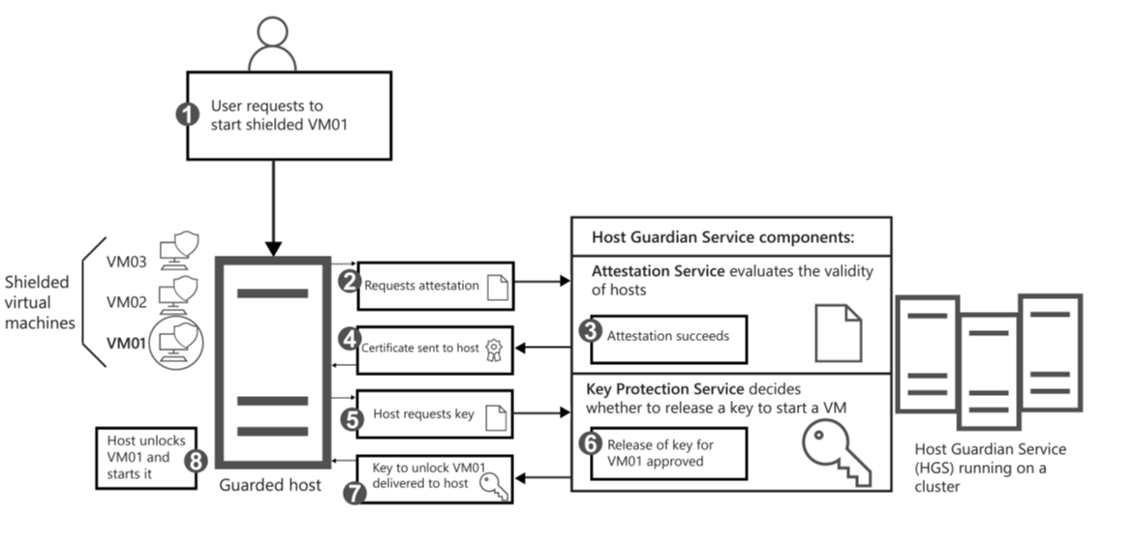
Process for powering-on shielded VMs
Notes:
Explain that the illustration represents the Process for powering-on shielded virtual machines. Elaborate on the process
User requests to start a shielded VM
Attestation succeeds or fails The attestation mode determines which checks are needed to successfully attest the host is healthy.
Attestation certificate sent to host If attestation is successful, a health certificate is sent to the host
Host requests VM key Guarded hosts need to request the necessary keys from the KPS on the HGS.
Key is released The KPS examines the health certificate provided by the guarded host to determine its validity.
Key is returned to host If the health certificate is valid, the KPS attempts to decrypt the provided secret from the guarded host
Host powers on shielded VM The guarded host can now unlock and power-on the shielded VM.

Slide 38
Lesson 3: Test your knowledge
Refer to the Student Guide for lesson-review questions

Slide 39
Lesson 4: Containers in Windows Server

Slide 40
Lesson 4 overview
By using container technology, you can package, provision, and run applications across diverse environments located on-premises or in the cloud
In this lesson, you are introduced to the concept of preparing and using Windows containers
  Topics:
    What are containers?
    Containers vs. virtual machines
    Overview of container isolation modes
    Manage containers using Docker
    Download container base images
    Run a Windows container
    Manage containers using Windows Admin Center
    Demonstration: Deploy containers by using Docker

Slide 41
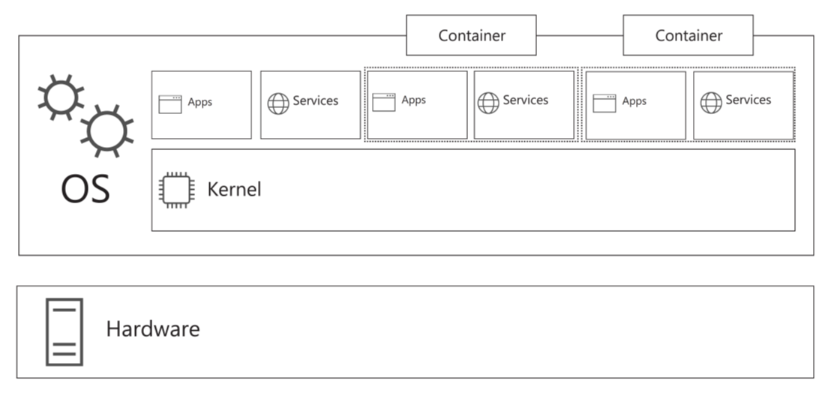
What are containers?
  Benefits of using containers:
    Ability to run anywhere; local workstation, servers, or provisioned in the cloud
    Isolation
    Increased efficiency
    A consistent development environment
Notes:
Introduce the concept of containers. Compare container technology to what used to be called application virtualization (APP-V). Describe how this is similar, but also explain that containers are more isolated due to the user mode boundary set for each container.

Slide 42
Containers vs. virtual machines (1 of 2)
Notes:
Describe the differences between virtual machines and containers. For the isolation feature, point out that containers in process isolation mode do provide lightweight isolation but don't provide as strong a security boundary. Using Hyper-V isolation mode increases this security by isolating each container in a lightweight VM. This is discussed in more detail in the next topic.

Slide 43
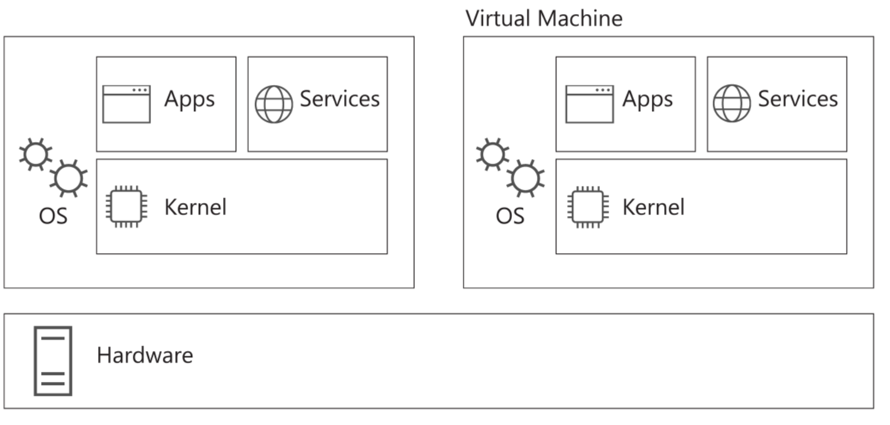
Containers vs. virtual machines (2 of 2)

Slide 44
Overview of container isolation modes
  Process Isolation:
    “Traditional” isolation mode
    Containers share the same kernel with each other and the host
    Each container has its own user mode
    Does not provide security-enhanced isolation
    Uses the following switch when starting a container using Docker:
      –isolation=process
  Hyper-V Isolation:
    Each container runs inside of a highly optimized virtual machine
    Each container gains its own kernel and an enhanced level of stability and security
    Also provides hardware-level isolation between each container and the host
    Uses the following switch when starting a container using Docker:
      –isolation=hyperv
Notes:
Describe the difference between process isolation and Hyper-V isolation modes. Process isolation runs like other container technologies such as Linux.
Point out that a discussion on using Docker will be presented later in this module.

Slide 45
Manage containers using Docker (1 of 2)
  Docker container:
    Application wrapped in a complete file system including:
      Code
      Runtime
      System tools
      Supporting files for the app
    Based upon open standards to run on all major operating systems
    Supports any runtime environment or infrastructure; on-premises or in the cloud
  Docker core platform includes:
    Docker Engine
      Runs on Linux, MacOS, or Windows-based operating systems
    Docker Client
      Command line interface to integrate with the engine
      Runs command to build and manage Docker containers
Notes:
Provide an overview of Docker and describe the tools included in the Docker Desktop. Point out that Docker
Desktop is designed to run on Windows 10 and provides an easy-to-use development environment for creating containerized apps.
The focus of this module is running containers on Windows Server 2019, so Docker Desktop is not covered in detail.

Slide 46
Manage containers using Docker (2 of 2)
  To install Docker on Windows Server:
    Install the Docker-Microsoft PackageManagement Provider:
    Install-Module -Name DockerMsftProvider -Repository PSGallery -Force
    Install the latest version of Docker:
    Install-Package -Name docker -ProviderName DockerMsftProvider
    May require a restart if the Containers Windows Server feature is also installed
  To support Docker on Windows 10:
    Install the Docker Desktop
      Provides a toolset used to build and distribute containerized apps
  Docker Hub
      A web-based library server used to register, store, and manage Docker images
      A community resource with access to over 100,000 shared container images

Slide 47
Download container base images
  Container base image:
    Provides a foundational layer of operating system services for a container
    Includes user mode operating system files to support apps
    Includes runtime files and dependencies required by the app
    Use the Docker pull command to download images
    docker pull mcr.microsoft.com/windows/nanoserver:1903
  Four primary container images are available:
    Window Server Core
      Subset of Windows Server APIs and support for traditional .NET framework apps
    Nano Server
      Support for the .NET Core APIs
    Windows
      Includes the full Windows API set
    Windows IoT Core
      Built to support IoT apps that run on ARM or x86/x64 processors
Notes:
Describe the container base images available as a starting point. It is important that the base image version matches the version of the host machine; otherwise, unexpected results may happen when the container runs. This is due to the fact that the kernel is shared between the host operating system and the containers.

Slide 48
Run a Windows container
  Methods used to create, manage, and run containers include:
    Automation using a Dockerfile text file and the docker build process
    Manually using Docker commands. Examples illustrated as shown:
Command | Description
Docker images | Lists the installed images on your container host
Docker run | Creates a container by using a container image
Docker commit | Commits the changes you made to a container to a new container image
Docker stop | Stops a running container
Docker rm | Removes an existing container
Notes:
Provide a general discussion on the commands and processes used to run and manage Windows containers.

Slide 49
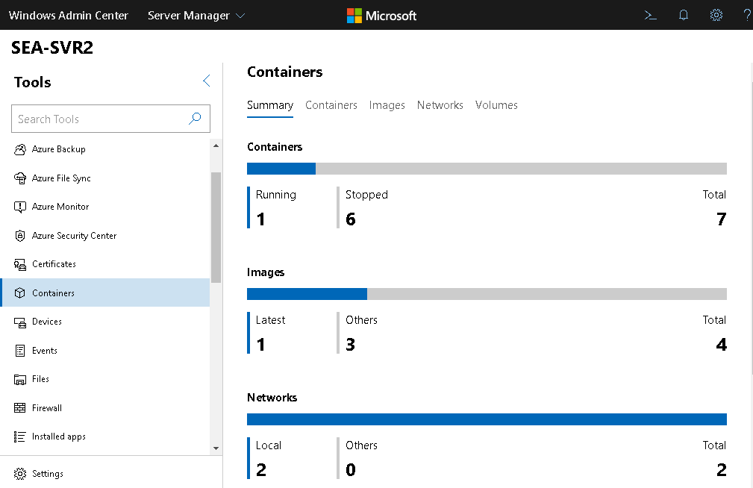
Manage containers using Windows Admin Center
  Windows Admin Center:
    Browser-based GUI used to manage Windows servers, clusters, and hyper-converged infrastructure
    Requires the Containers extension:
      Summary
      Containers
      Images
      Networks
      Volumes
Notes:
Describe how the Windows Admin Center can be used to manage containers. Be sure to point out that extensions are often updated and new or updated features may be available for the tool.

Slide 50
Demonstration: Deploy containers by using Docker
Install Docker on Windows Server
Download and run a Windows container
Use Windows Admin Center to manage containers
Notes:
Demonstration detailed steps
Preparation Steps
The following virtual machines are required for this demonstration:
WS-011T00A-SEA-DC1
WS-011T00A-SEA-ADM1
WS-011T00A-SEA-SVR1
Sign in as Contoso\Administrator by using Pa55w.rd as the password.
Note: To save time, you might consider Installing Docker and restarting the server before performing the demonstration.
Install Docker on Windows Server
On SEA-ADM1, from the task bar, open Microsoft Edge.
On the Favorites bar, select Windows Admin Center.
In the Windows Security box, enter the following credentials:
User name: Contoso\Administrator
Password: Pa55w.rd
On the All connections page, select SEA-SVR1.
On the Specify your credentials page, select Use another account for this connection. Provide the Contoso\Administrator credentials, and then select Continue.
In the Tools list, select PowerShell. Provide the Contoso\Administrator credentials, and then press Enter. You are now connected to SEA-SVR1 using a Remote PowerShell connection.
At the PowerShell command prompt, type the following command, and then press Enter:
Install-Module -Name DockerMsftProvider -Repository PSGallery -Force
At the NuGet Provider prompt, enter Y for yes, and then press Enter.
At the PowerShell command prompt, type the following command, and then press Enter:
Install-Package -Name docker -ProviderName DockerMsftProvider
At the confirmation prompt, enter A for Yes to All, and then press Enter.
After the installation is complete, restart the computer by using the following command:
Restart-Computer -Force

Slide 51
Demonstration: Deploy containers by using Docker (2 of 3)
Install Docker on Windows Server
Download and run a Windows container
Use Windows Admin Center to manage containers
Notes:
Download and run a Windows container
After SEA-SVR1 restarts, verify the installed version of Docker by using the following command. Note that you may have to reconnect to the remote PowerShell connection:
Get-Package -Name Docker -ProviderName DockerMsftProvider
To view whether any Docker images are currently pulled, use the following command:
Docker images
Notice that there are no images in the local repository store.
To review docker base images from the online Microsoft repository, use the following command:
Docker search Microsoft
Notice the variety of base images; each represents various runtime scenarios.
To download and run a sample hello-world test Nano Server image, run the following command:
docker container run hello-world:nanoserver
Notice that an error report that Docker cannot find the image is generated initially. The container image is then downloaded and run. The Hello message indicates a successful download and run of the container base image.
5. To download a Nano server image that matches the host operating system version of 1809, run the following command:
docker pull mcr.microsoft.com/windows/nanoserver:1809
It may take several minutes for the image to finish downloading.
6. Switch to SEA-SVR1. (Note the following tasks have to be performed locally on the server, as they do not function in a remote session.)
7. To view the Docker images that are currently pulled, use the following command:
Docker images
Notice that there are now images listed in the local repository store.
8. To run the container in interactive mode, type the following command:
Docker run -it --name NanoImage mcr.microsoft.com/windows/nanoserver:1809
Interactive mode opens a command console for the container so you can perform commands within the container itself. If you do not provide the -it switch, the container runs and then shuts down automatically.
9. To verify that you are focused on the container in interactive mode, type the following command:
hostname
The hostname will be a random name for the container itself.
10. Switch back to SEA-ADM1 and ensure that SEA-SVR1 is still connected to Windows Admin Center. In the Tools list, select Processes. At the prompt, select Continue.

Slide 52
Demonstration: Deploy containers by using Docker (3 of 3)
Install Docker on Windows Server
Download and run a Windows container
Use Windows Admin Center to manage containers
Notes:
In the Processes list, take note of the CExecSvc.exe process. This is the Container Execution service, which uses a named pipe to communicate with Docker and the VMcompute services on the host. This service indicates that the container is running in process isolation mode, which still uses the kernel from the host machine.
11. Switch to SEA-SVR1.
12. To close the interactive session with the container, use the following command:
Exit
13. To verify that the container has stopped, use the following command:
docker ps
14. To run the a container in Hyper-V isolation mode, type the following command:
Docker run -it --name NanoHVImage --isolation=hyperv mcr.microsoft.com/windows/nanoserver:1809
15. Switch back to SEA-ADM1. In the Processes list, notice that the CExecSvc.exe process is not running. This indicates that the container is running in Hyper-V isolation mode, which does not share processes with the host machine.
16. In the Tools list, select PowerShell. Provide the Contoso\Administrator credentials, and then press Enter. You are now connected to SEA-SVR1 using a Remote PowerShell connection.
17. In the remote PowerShell session, enter the following command:
docker ps
Take note of the container ID; you will use it to stop the Container.
18. In the remote PowerShell session, enter the following command:
docker stop <ContainerID>
19. Rerun the docker ps command to confirm that the container has stopped.
Use Windows Admin Center to manage containers
20. On SEA-ADM1, ensure that SEA-SVR1 is targeted in the Windows Admin Center, and then select the Containers tool.
21. Browse through each of the Summary, Containers, Images, Networks, and Volumes tabs.
This is the last demonstration in this module. You can revert the virtual machines.

Slide 53
Lesson 4: Test your knowledge
Refer to the Student Guide for lesson-review questions

Slide 54
Lesson 5: Overview of Kubernetes

Slide 55
Lesson 5 overview
Kubernetes is open-source orchestration software used to efficiently deploy, manage, and scale containers in a hosted environment
In this lesson, you are introduced to the concept of Kubernetes and its benefits for managing container technology
  Topics:
    What is Windows container orchestration?
    Overview of Kubernetes on Windows
    Deploy Kubernetes resources

Slide 56
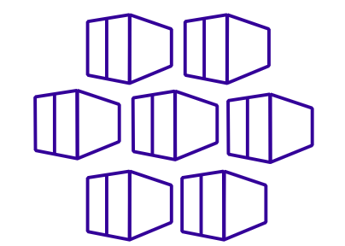
What is Windows container orchestration?
  Container orchestration involves the following tasks:
    Scheduling
    Affinity/Anti-affinity
    Health monitoring
    Failover
    Scaling
    Networking
    Service discovery
    Coordinated application upgrades
  Types of orchestration tools:
    Kubernetes
    Docker Swarm
    Apache Mesos
Notes:
Describe the concept of container orchestration. Point out that if you have a small number of containers and applications, it might not be that difficult to manage. However, if you have hundreds or thousands of containers and applications, management becomes more complex and requires automation using orchestrators.

Slide 57
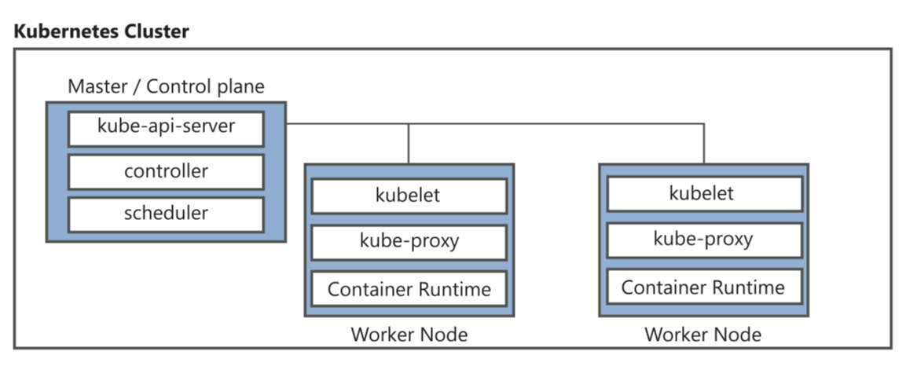
Overview of Kubernetes on Windows (1 of 2)
  Based upon cluster technology where a centralized Master/Control plane is responsible for scheduling and managing components located on multiple nodes within the cluster
Notes:
Provide a high-level overview of what a Kubernetes cluster is and how it is made up of a Master/Control plane and Windows or Linux-based worker nodes.

Slide 58
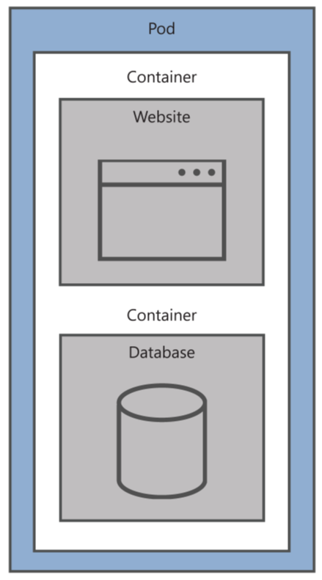
Overview of Kubernetes on Windows (2 of 2)
  Kubernetes Pods:
    A workload consisting of one or more containers disbursed throughout multiple worker nodes within the cluster
  Includes information about the shared storage, network configuration, and specification on how to run its packaged containers
  Defined as Pod Templates
Notes:
Explain that a Kubernetes workload might be made up of several Docker containers disbursed throughout multiple worker nodes in what is called a Pod.

Slide 59
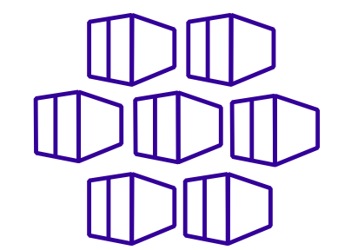

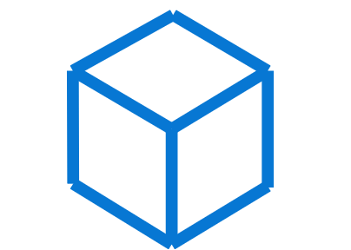

Deploy Kubernetes resources
Create a Kubernetes master
Configure network solution
Join worker nodes
Manage Kubernetes resources
Linux operating system
Kubeadm used to initialize the master and manage cluster nodes
Used to create routable cluster subnets
Linux CNI plugin
Flannel, ToR, OvS, OVN
Windows Server
Linux
Kubectl used to deploy and manage Kubernetes pods
Cloud services such Azure Kubernetes Service (AKS) reduce many of the challenges of manually configuring Kubernetes clusters by providing a hosted Kubernetes environment
Notes:
Describe the high level process for configuring Kubernetes resources.
Point out that Kubernetes 1.14 supports Windows Server 2019 and Windows Server version 1809 and later as worker nodes.

Slide 60
Lesson 5: Test your knowledge
Refer to the Student Guide for lesson-review questions

Slide 61
Instructor-led labs: Implementing and configuring virtualization in Windows Server
Creating and configuring VMs
Installing and configuring containers

Slide 62
Lab: Implementing and configuring virtualization in Windows Server
  Exercise 1: Creating and configuring VMs
  Exercise 2: Installing and configuring containers
Sign-in information for the exercise(s):
  Virtual machines:
    WS-011T00A-SEA-DC1
    WS-011T00A-SEA-ADM1
    WS-011T00A-SEA-SVR1
  Username: Contoso\Administrator
  Password: Pa55w.rd

Slide 63
Lab scenario
Contoso is a global engineering and manufacturing company with its head office in Seattle, USA. An IT office and data center are in Seattle to support the Seattle location and other locations.
Contoso recently deployed a Windows Server 2019 server and client infrastructure.
Due to many physical servers being currently underutilized, the company plans to expand virtualization to optimize the environment. Because of this, you decide to perform a proof of concept to validate how Hyper-V can be used to manage a virtual machine environment.
Also, the Contoso DevOps team wants to explore container technology to determine whether they can help reduce deployment times for new applications and to simplify moving applications to the cloud. You plan to work with the team to evaluate Windows Server containers and to consider providing Internet Information Services (Web services) in a container.

Slide 64
Lab-review questions
In Exercise 1, you created a Hyper-V virtual switch as a Private Network. Describe the impact to your virtual network by using this type of virtual switch.
In Exercise 2, which command did you use to browse the Docker base images from the online repository?

Slide 65
Lab-review answers
In Exercise 1, you created a Hyper-V virtual switch as a Private Network. Describe the impact to your virtual network by using this type of virtual switch.
  The Private Network only allows communication between virtual machines running on the host machine.
In Exercise 2, which command did you use to browse the docker base images from the online repository?
  Docker search Microsoft

Slide 66
Module-review questions (1 of 3)
Which of the following are requirements for installing the Hyper-V server role? Choose two.
  A 32-bit processor
  Minimum 32 GB of memory
  A 64-bit processor
  BitLocker enabled
  Intel VT or AMD-V enabled
You plan to enable nested virtualization on a Hyper-V host. What do you need to do to ensure that the nested VM can route to external destinations?
  Enable BitLocker
  Enable MAC address spoofing
  Enable Device Guard
  Configure a switch with the Internal Network type
  Configure a switch with the Private Network type

Slide 67
Module-review questions (2 of 3)
Which of the following are true for considerations when implementing a Host Guardian service? Choose two.
  A new Active Directory forest is created dedicated to the Host Guardian service.
  The Host Guardian service must be installed on a server containing the Linux operating system.
  The Host Guardian service must be installed in a virtual machine.
  The Host Guardian service uses certificates for signing and encryption tasks.
  The Host Guardian service must be installed in the same domain as the Hyper-V guarded hosts.
Which of the following are requirements for creating a shielded template disk? Choose two.
  A generation 2 virtual machine
  A basic disk
  A generation 1 virtual machine
  A dynamic disk
  Must be generalized

Slide 68
Module-review questions (3 of 3)
You download a container base image. When you attempt to create and run a container using the base image, you get an error message that relates to incompatibility with the host machine. What should you do?
  Download a new container base image that matches the version of the operating system installed on the host machine.
  Run the container using the --isolation=process switch.
  Update the version of Docker installed on the host machine.
  Install a self-signed authentication certificate on the host machine.
  Use BitLocker to encrypt the Operating system drive of the host machine.
Which of the following can be used as worker nodes in a Kubernetes cluster? Choose two.
  Nano Server
  Windows Server 2019
  MacOS
  Linux

Slide 69
Module-review answers (1 of 2)
Which of the following are requirements for installing the Hyper-V server role? Choose two.
  A 64-bit processor
  Intel VT or AMD-V enabled
You plan to enable nested virtualization on a Hyper-V host. What do you need to do to ensure that the nested VM can route to external destinations?
  Enable MAC address spoofing
Which of the following are true for considerations when implementing a Host Guardian service? Choose two.
  A new Active Directory forest is created dedicated to the Host Guardian Service
  The Host Guardian Service uses certificates for signing and encryption tasks

Slide 70
Module-review answers (2 of 2)
Which of the following are requirements for creating a shielded template disk? Choose two.
  A basic disk
  Must be generalized
You download a container base image. When you attempt to create and run a container using the base image, you get an error message that relates to incompatibility with the host machine. What should you do?
  Download a new container base image that matches the version of operating system installed on the host machine
Which of the following can be used as worker nodes in a Kubernetes cluster. Choose two.
  Windows Server 2019
  Linux

Slide 71
Thank you.

